Slide 1


Introduction to Streaming
using

Slide 2
What is Streaming?
Data is generated continuously from one or many sources
Sources typically send in data simultaneously
Data comes in small packages (kilobyte scale) in succession

Slide 3
Why use Streaming?
A lot of applications use continuously-updated data
Examples:
Sensors in vehicles, industrial equipment, and machinery send data to streaming for performance measurement.
A website tracking geo-location data from customer’s phones, which is gathered by streaming, so the website can make recommendations of which restaurants to visit
Solar power company monitoring panel performance through streaming
Online gaming company collecting streaming data about player-game interactions
Notes:
reduceByKeyAndWindow(func, windowLength, slideInterval, [numTasks])
When called on a DStream of (K, V) pairs, returns a new DStream of (K, V) pairs where the values for each key are aggregated using the given reduce function func over batches in a sliding window. Note: By default, this uses Spark's default number of parallel tasks (2 for local mode, and in cluster mode the number is determined by the config property spark.default.parallelism) to do the grouping. You can pass an optional numTasks argument to set a different number of tasks
reduceByKeyAndWindow(func, invFunc, windowLength, slideInterval, [numTasks])
A more efficient version of the above reduceByKeyAndWindow() where the reduce value of each window is calculated incrementally using the reduce values of the previous window. This is done by reducing the new data that enters the sliding window, and “inverse reducing” the old data that leaves the window. An example would be that of “adding” and “subtracting” counts of keys as the window slides. However, it is applicable only to “invertible reduce functions”, that is, those reduce functions which have a corresponding “inverse reduce” function (taken as parameter invFunc). Like in reduceByKeyAndWindow, the number of reduce tasks is configurable through an optional argument. Note that checkpointing must be enabled for using this operation.

Slide 4
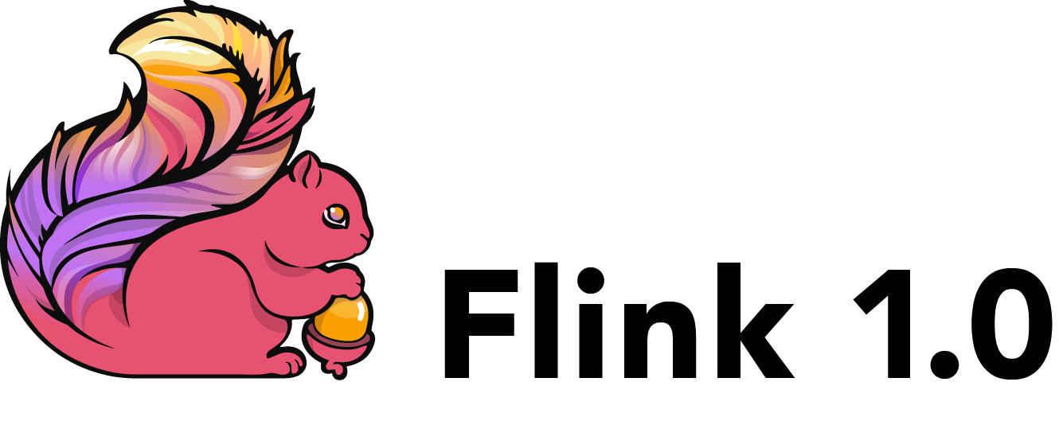




Popular Streaming Tools
Storm
Flink
Kinesis
Samza
Kafka
Apache Spar
Notes:
reduceByKeyAndWindow(func, windowLength, slideInterval, [numTasks])
When called on a DStream of (K, V) pairs, returns a new DStream of (K, V) pairs where the values for each key are aggregated using the given reduce function func over batches in a sliding window. Note: By default, this uses Spark's default number of parallel tasks (2 for local mode, and in cluster mode the number is determined by the config property spark.default.parallelism) to do the grouping. You can pass an optional numTasks argument to set a different number of tasks
reduceByKeyAndWindow(func, invFunc, windowLength, slideInterval, [numTasks])
A more efficient version of the above reduceByKeyAndWindow() where the reduce value of each window is calculated incrementally using the reduce values of the previous window. This is done by reducing the new data that enters the sliding window, and “inverse reducing” the old data that leaves the window. An example would be that of “adding” and “subtracting” counts of keys as the window slides. However, it is applicable only to “invertible reduce functions”, that is, those reduce functions which have a corresponding “inverse reduce” function (taken as parameter invFunc). Like in reduceByKeyAndWindow, the number of reduce tasks is configurable through an optional argument. Note that checkpointing must be enabled for using this operation.

Slide 5

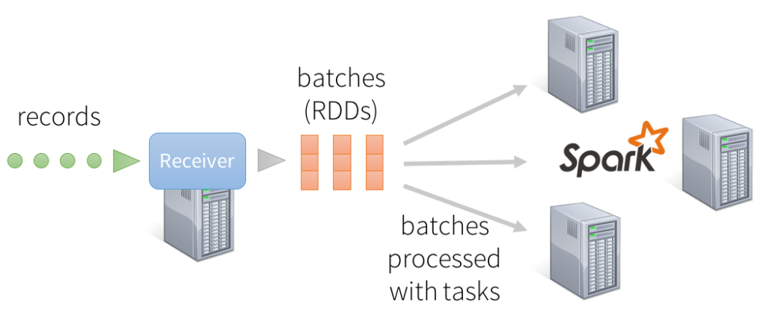
What is Apache Spark Streaming?
Spark is general purpose and is widely used
Spark connects with a lot of the previously mentioned streaming tools
Fault tolerant thanks to projects like Hadoop Distributed File System (HDFS)

Slide 6









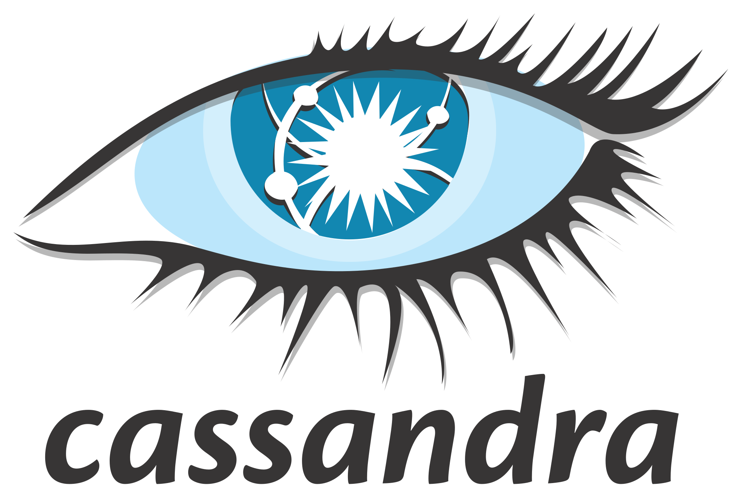



Apache Spark Structure
Programming Language API
Spark SQL
Spark Streaming
MLlib
GraphX
Spark Core
Data Source API

Slide 7


In-depth Example Application (finally)
Spark streaming allows for tracking frequently-updated datasets
Can use it to track most popular hashtags in 5 mins windows based on their counts in a Twitter stream, and by using the StreamingContext function.
Twitter HTTP
Client App

Slide 8
Next Video: The Setup

